Slide 1

PIZZA SALES SQL ANALYSIS

Slide 2

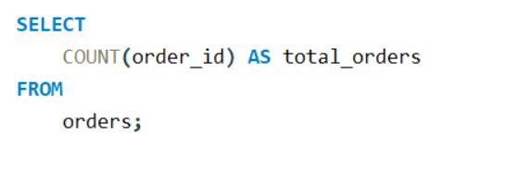
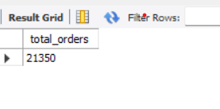
Retrieve the total number of orders placed.
QUERY
OUTPUT

Slide 3
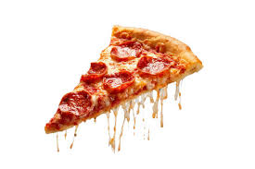
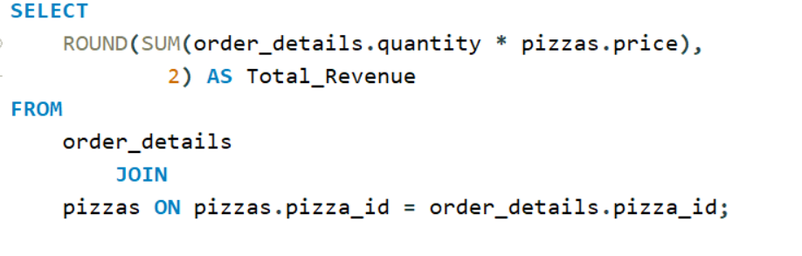
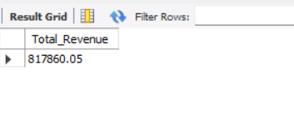
Calculate the total revenue generated from pizza sales.
QUERY
OUTPUT

Slide 4
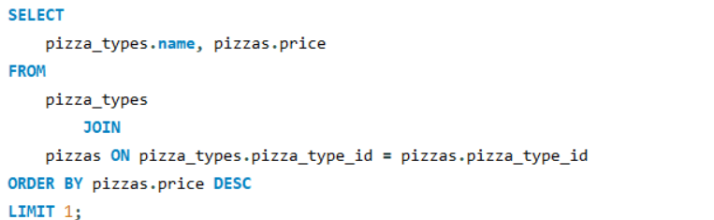
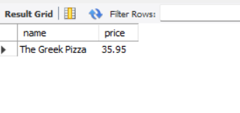
Identify the highest-priced pizza.
QUERY
OUTPUT

Slide 5
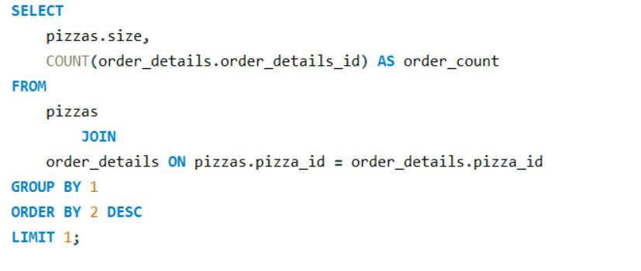
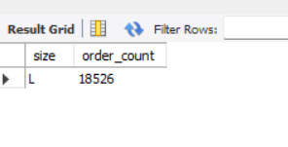
Identify the most common pizza size ordered.
QUERY
OUTPUT

Slide 6
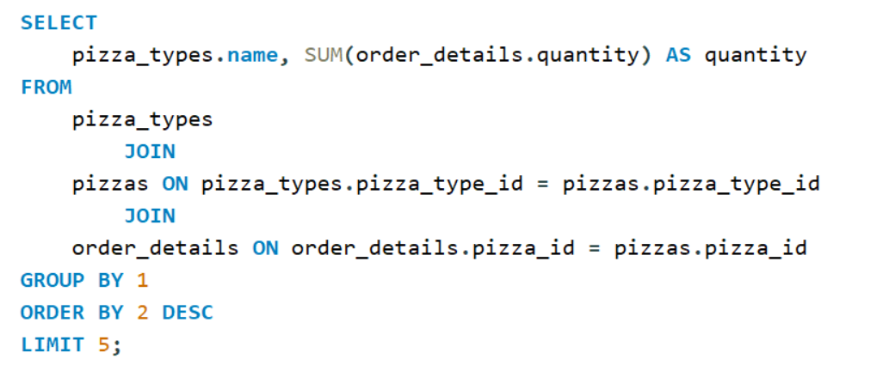
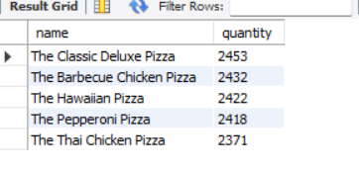
List the top 5 most ordered pizza types along with their quantities.
QUERY
OUTPUT

Slide 7
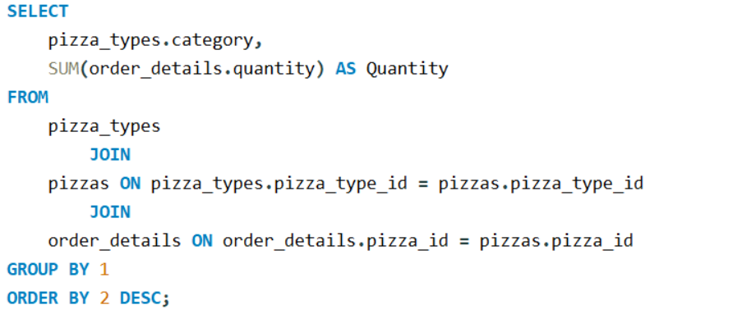
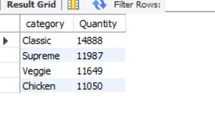
Join the necessary tables to find the total quantity of each pizza category ordered.
QUERY
OUTPUT

Slide 8
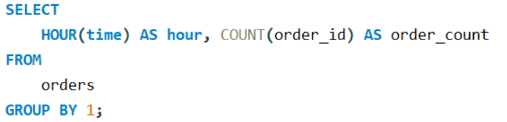
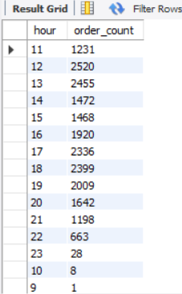
Determine the distribution of orders by hour of the day.
QUERY
OUTPUT

Slide 9
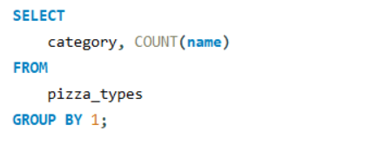
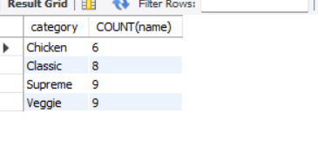
Join relevant tables to find the category-wise distribution of pizzas.
QUERY
OUTPUT

Slide 10
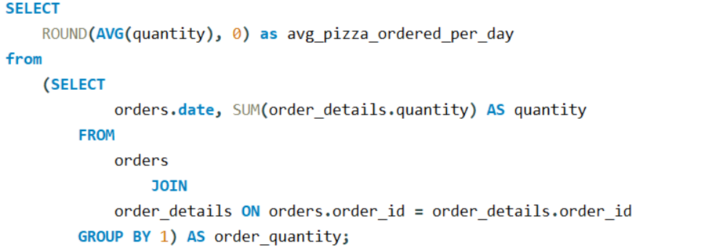
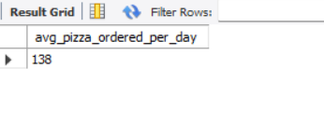
Group the orders by date and calculate the average number of pizzas ordered per day.
QUERY
OUTPUT

Slide 11
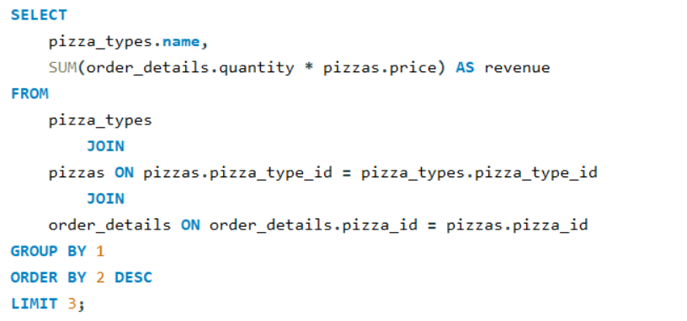
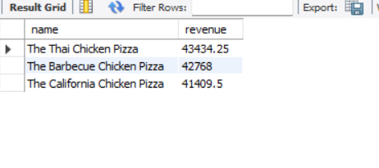
Determine the top 3 most ordered pizza types based on revenue.
QUERY
OUTPUT

Slide 12
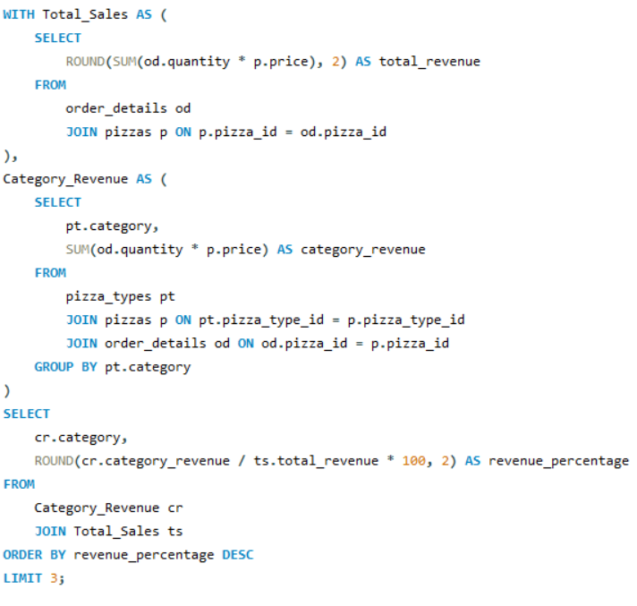
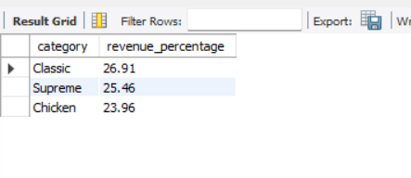
Calculate the percentage contribution of each pizza type to total revenue.
QUERY
OUTPUT

